Slide 1
Useless Machine, Useful Application
108062103 莊鈞堯
108062304 黃子軒

Slide 2
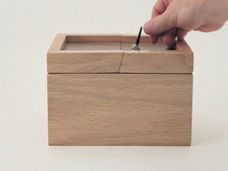
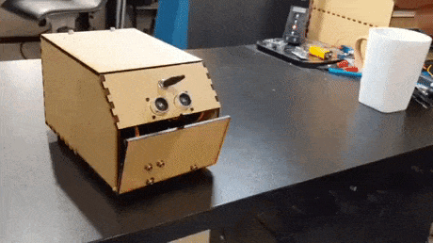
What Is Useless Machine?
Useless Machine is a useless thing that makes you angry.
Usually, it is a box with a switch, so we also call it “useless box.”
When you try to touch the switch, the machine tries its best to trick you.
The following pictures are some examples of useless machines.

Slide 3
What Is Useful Application?
Classic useless machines only make people angry, so we try to make it useful.
However, we still want to keep the features of classic useless machines.
Therefore, we designed 3 modes for this useless machine:
1. Normal Switch (NS)
2. Useless Box (UB)
3. Useful Car (UC)

Slide 4
1. Normal Switch (NS)
Features
You can control the switch with a Bluetooth app.
If you do so, the machine will toggle the switch by itself.(Useful)
On the other hand, if you try to toggle the switch with your bare hands, then the useless machine will push the switch back. (Useless)
The switch also connects to an external device, so the device will work when the switch is turned on in this mode.

Slide 5
2. Useless Box (UB)
Features
You can decide what kind of useless box you want to play with.
3 different boxes you may choose:
Classic, Dodge, or Advance.
If no choices were made, we will give you a random box.
Don’t be greedy! You will see “Err” on 7-segment display if you choose more than 1 useless box, and of course, it won’t play with you.

Slide 6
2.1 Classic Mode
Features
The box pushes the switch back once you toggle the switch.
Most useless boxes are dangerous because the box may hurt you when it tries to toggle the switch but your hands are still there.
Don’t worry! We have IR sensors detecting whether your hands are close or not, so the box will push it back only when your hands leave.

Slide 7
2.2 Dodge Mode
Features
The box runs away when you try to touch the switch.
In most situations, the box will go to the opposite side.
It runs for about 3 seconds and then stops.

Slide 8
2.3 Advance Mode
Features
The box competes with you for toggling the switch.
Advance Mode is only recommended for high-level players.
Competition means that it is dangerous because the box won’t let you win, even if your hands are still there.
Note that the safe method in 2.1 is still applied here, but it will work only when the box wants to push the switch back after the competition ends.

Slide 9
3. Useful Car (UC)
Features
It becomes a remote car that can be controlled by the Bluetooth app.
You can let the car go Forward, Backward, Left or Right.
When left or right is chosen, the car stay there and change direction, so it won’t go forward or backward at the same time.
You can still toggle the switch with Bluetooth app in this mode.

Slide 10
4. How To Change Mode?
1. Mode can be changed with pushbutton or Bluetooth app, and the current mode will show on 7-segment display (NS = 0, UB = 1, UC = 2.)
2. Use sw0～sw2 to change the useless box you want in UB mode, and LED will show what kind of useless box you want.
3. Have Fun!

Slide 11
Thank You For Your Listening!

